Slide 1

P peline
The Data
Infrastructure Issues and Big Data
© Jennifer Mankoff
The Data Pipeline; HCII; Spring 2014

Slide 2
Goals for today
Review last Tuesday
Quiz 8
Quiz 7 answers
Discuss infrastructure issues for Big Data
Talk about streaming data
Look at Regression algorithms
Discuss Machine Learning for Big Data
Talk about Byte 6

Slide 3
Review: Decision Trees & Naïve Bayes
Minimum description length principal
- just Keep It Simple, …

Slide 4
Review: Decision Trees & Naïve Bayes
Minimum description length principal
Decision trees are simple and easily learned
Add nodes based on information gain
Decision trees pros
Open world assumption
Fast to learn and use
Easy to interpret and understand
Decision trees cons
Prone to overfitting – handle this by pruning

Slide 5
Review: Decision Trees & Naïve Bayes
Minimum description length principal
Decision trees are simple and easily learned
Add nodes based on information gain
Naïve Bayes – based on Bayes’ law
P(F | C_{i}) P(C_{i})
Likelihood * Prior
P(C_{i} | F) =
=
P(F)
Evidence

Slide 6
Review: Decision Trees & Naïve Bayes
Minimum description length principal
Decision trees are simple and easily learned
Add nodes based on information gain
Naïve Bayes pros
Takes priors into account
Robust even when features are missing
Naïve Bayes cons
Assumptions: Independence; Closed world
Fails when things are highly conditional
Fails when data is highly skewed

Slide 7
Goals for today
Review last Tuesday
Quiz 8
Quiz 7 answers
Discuss infrastructure issues for Big Data
Talk about streaming data
Look at Regression algorithms
Discuss Machine Learning for Big Data
Talk about Byte 6

Slide 8
Goals for today
Review last Tuesday
Quiz 8
Quiz 7 answers
Discuss infrastructure issues for Big Data
Talk about streaming data
Look at Regression algorithms
Discuss Machine Learning for Big Data
Talk about Byte 6

Slide 9
What is Big Data?
Mining Massive Data Sets: http://www.stanford.edu/class/cs246 Book free online: http://i.stanford.edu/~ullman/mmds.html#latest
Want to do it yourself in Python? Jurney’s ‘Agile Data Science’ will get you to a web app analyzing your gmail
Want to understand the tradeoffs in systems and platforms? Manoochehri’s ‘Data Just Right’
Notes:
Too much to cover it all in this class!

Slide 10
CAP Theorem
Cannot maximize Consistency, Availability and Partition Tolerance (in the event of a partial failure).
Every data storage solution makes tradeoffs

Slide 11
Example: Relational Databases
Maximize Consistency
Consider financial data
Error or inconsistency is not allowed
Delays are minimized

Slide 12
Alternatives to relational databases
Write performance (collect lots of data quickly): Redis (key-value store)
Important at data collection time
Important for sites generating a lot of content
Maybe it’s ok if a crash loses a small amount of data
Slower to query things not in the key
Scales to multiple machines
“Redis is an open source, BSD licensed, advanced key-value store. It is often referred to as a data structure server since keys can contain strings, hashes, lists, sets and sorted sets.”

Slide 13
Going beyond read and write
Supporting access and transformation of large, unstructured data
Hadoop’s MapReduce framework (a form of parallelism)
“a framework that allows for the distributed processing of large data sets across clusters of computers using simple programming models.”

Slide 14
Going beyond read and write
Supporting access and transformation of large, unstructured data
Hadoop’s MapReduce framework (a form of parallelism)
Map data ‘shards’ with keys onto many nodes
Shuffle sort ‘shards’ by aggregating them by key to increase the efficiency of processing
Reduce by processing the data

Slide 15
Going beyond read and write
Supporting access and transformation of large, unstructured data
Hadoop’s MapReduce framework (a form of parallelism)
Apache Hive: Interactive querying for Hadoop
A way to manage distributed data (query, insert, etc.) “Hive provides a mechanism to project structure onto ... and query the data using a SQL-like language called HiveQL.”

Slide 16
Pros and Cons of MapReduce
Not ideal for ad-hoc query tasks
Slow for iterative data analysis
Good for normalization or processing
Good for batch work
Does not require that data fit a schema

Slide 17
A solution focused on Analytics
Google’s Big Query
“Analyze terabytes of data in seconds… bulk load your data … REST access”

Slide 18
A solution focused on Analytics
Google’s Big Query
Based on Dremel (a schema-based SQL/like system that can handle very large data sets very quickly).
Append-only system
No install required (or allowed)
Good if you don’t have an existing distributed infrastructure
Good for supporting visualizations and dashboards

Slide 19
How is it so fast?
Data stored in tables, but organized in columns rather than rows
Reduces the amount of data necessary to load into memory
Query results returned as JSON objects & can create new tables when very large
Limited by Google’s servers’ available memory

Slide 20
Case Study [Bad Data Handbook Ch 12]
Studying online text data (NLP)
Scraped data into Apache CouchDB
JSON based
Schema-less / Document oriented
HTTP support
Supports MapReduce
Collected 70GB of blog posts
[McNamara]

Slide 21
Case Study [Bad Data Handbook Ch 12]
Poor debugging experience
Error output poor
MapReduce errors occurred only at reduce stage (slow debug cycle)
Indexing data took days; failures could occur at any point
-> Fast write, slow & difficult querying

Slide 22
Relating infrastructure solutions to the Data Pipeline
Understand your data problem first
Outsource things that aren’t key to your contribution
Start small -- test on a subset of data to find basic problems first
Plan to scale up

Slide 23
Relating infrastructure solutions to the Data Pipeline
Collecting Data: File System? Or Redis [write heavy]

Slide 24
Relating infrastructure solutions to the Data Pipeline
Collecting Data: FS/Redis [write heavy]
Organizing and Processing for future needs: Hadoop/Map Reduce related tools [flexible, not always efficient, not enterprise-ready]
Lacks automated backups
Lacks interoperability with existing filesystems
Better for batch than interactive tasks

Slide 25
Relating infrastructure solutions to the Data Pipeline
Collecting Data: FS/Redis [write heavy]
Organizing and Processing for future needs: Hadoop/Map Reduce related tools [flexible, not always efficient, not enterprise-ready]
Visualization: Google Big Query + D3
Summarization: Google Big Query
In the cloud
Network speed a limiting factor

Slide 26
Relating infrastructure solutions to the Data Pipeline
Collecting Data: FS/Redis [write heavy]
Organizing and Processing for future needs: Hadoop/Map Reduce related tools [flexible, not always efficient, not enterprise-ready]
Visualization: Google Big Query + D3
Summarization: Google Big Query
Machine Learning: About to discuss

Slide 27
Goals for today
Review last Tuesday
Quiz 8
Quiz 7 answers
Discuss infrastructure issues for Big Data
Talk about streaming data
Look at Regression algorithms
Discuss Machine Learning for Big Data
Talk about Byte 6

Slide 28
Mining data from streams [e.g., Twitter]
Don’t know entire data set in advance
Cannot store entire stream
Ideal for ‘online learning’ (can do this with regression using stochastic gradient descent learning algorithm)
Train on initial data
Each new example in the stream updates the model

Slide 29
Need to sample the stream at fixed size
Just use the last n elements?
Notes:
Assuming the stream is sufficiently large..

Slide 30
Need to sample the stream
Just use the last n elements?
Sample 1/n as far back as we can?

Slide 31
Need to sample the stream
Just use the last n elements?
Sample 1/n as far back as we can?
Account for duplicates & so on with weighted samples
Or
Sample 1/n users but keep entire user log

Slide 32
Other sampling strategies
What queries are more frequent today than yesterday?
- just need last two days (sliding window)

Slide 33
Other sampling strategies
What queries are more frequent today than yesterday?
- just need last two days (sliding window)
Which pages are getting an unusual number of hits this hour?
- Count the number of 1s in last N elements (can still be a big problem; algthms for this in Ullman Ch 4)

Slide 34
Goals for today
Review last Tuesday
Quiz 8
Quiz 7 answers
Discuss infrastructure issues for Big Data
Talk about streaming data
Look at Regression algorithms
Discuss Machine Learning for Big Data
Talk about Byte 6

Slide 35
Estimated Regression Model
y
Observed y for x_{i}
Random Error for x_{i}
e_{i}
b₁
Predicted for x_{i}
b₀
x
x_{i}
x
The individual random error terms e_{i} have a mean of zero
Notes:
This works in two dimensions

Slide 36
Least Squares Regression
b₀ and b₁ must minimize
y
Observed Value of y for x_{i}
e_{i}
Estimated Slope = b₁
Predicted Value for x_{i}
Intercept = b₀
x
Notes:
Note we can replace y-cap with b0 – b1x

Slide 37
Moving to n dimensions
Given training examples:
x_{1..i} in R^{n} [our feature vectors]
And labels
y_{1..i} in R
we want to learn f(x) = w^{T}x + b

Slide 38
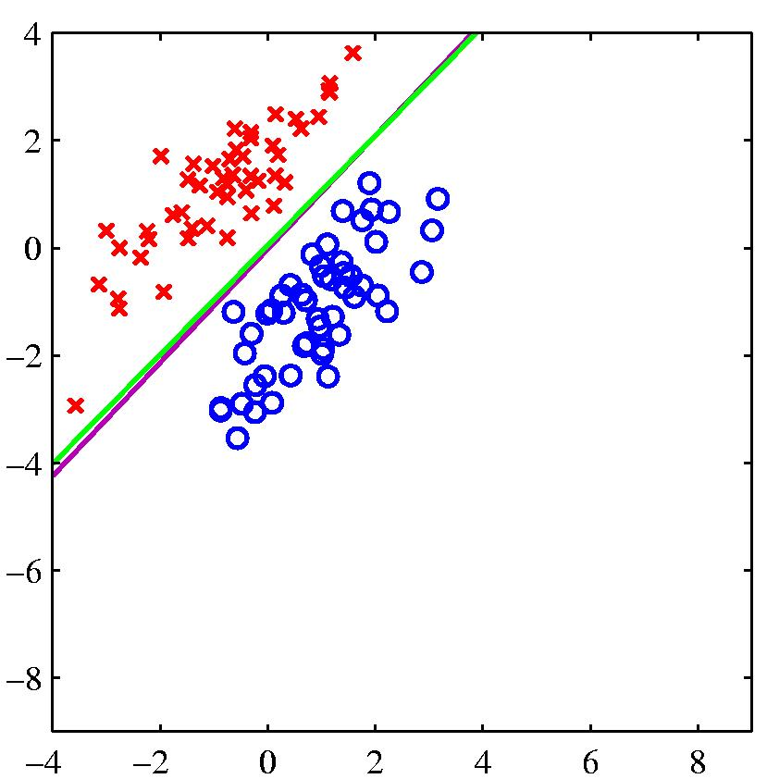
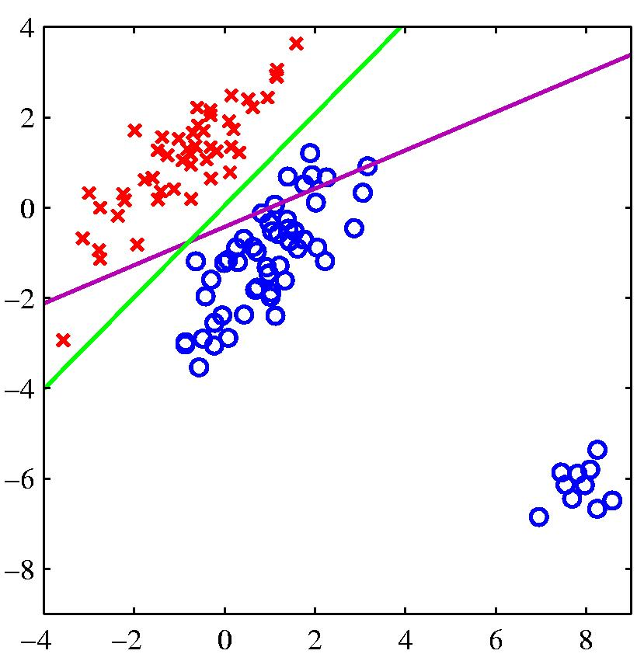
Problems with using least squares for classification
logistic regression
least squares regression
If the right answer is 1 and the model says 1.5, it loses, so it changes the boundary to avoid being “too correct”

Slide 39
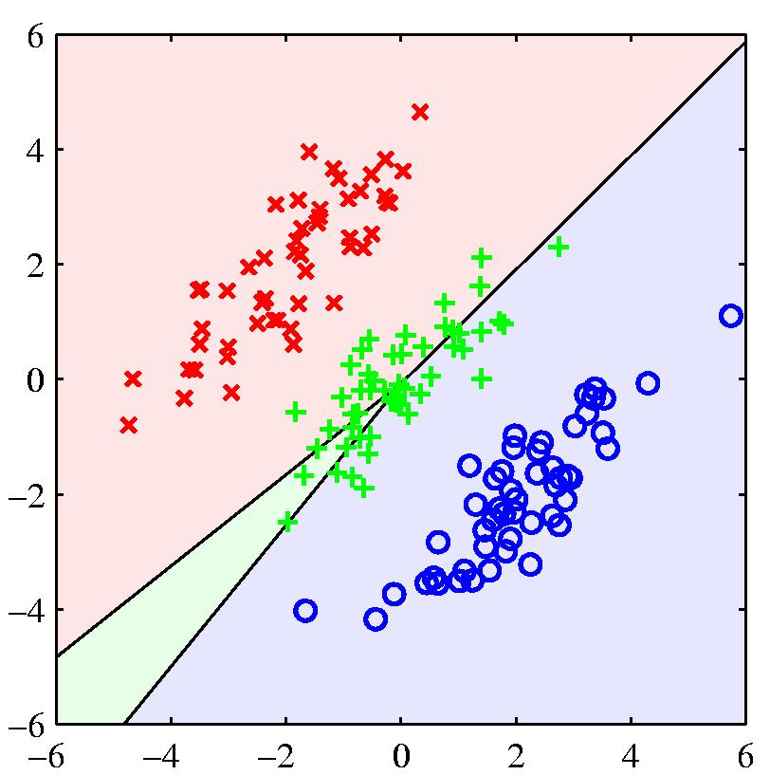
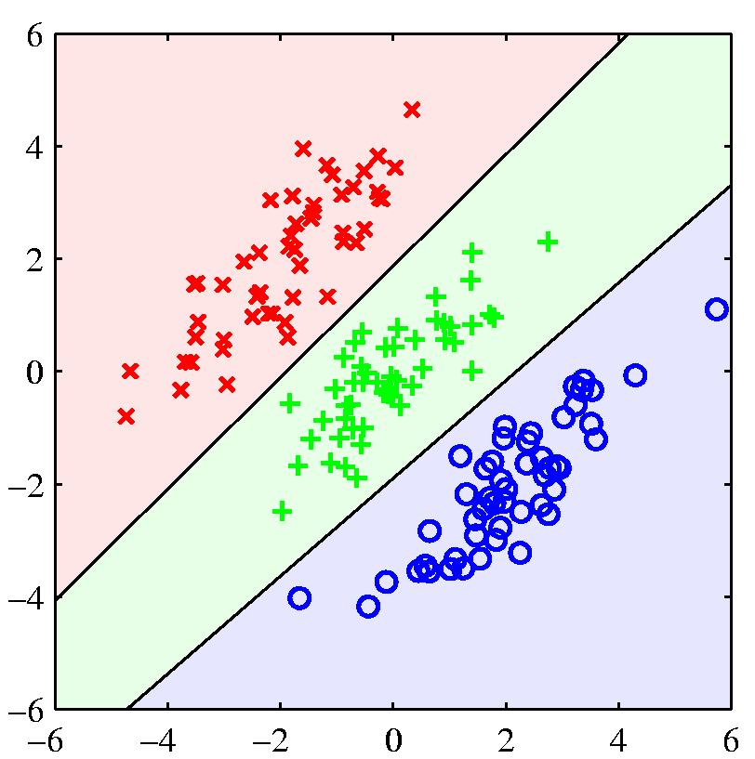
Another example where least squares regression gives poor decision surfaces

Slide 40
Goal of Logistic Regression
Key idea: instead of predicting a number in R, predict the probability of a class label.
p+ = P(class is positive|features) p- = P(class is negative|features)

Slide 41
Goal of Logistic Regression
Key idea: instead of predicting a number in R, predict the probability of a class label.
p+ = P(class is positive|features) p- = P(class is negative|features)
Base p on the projection that gives the best separation of the classes.

Slide 42
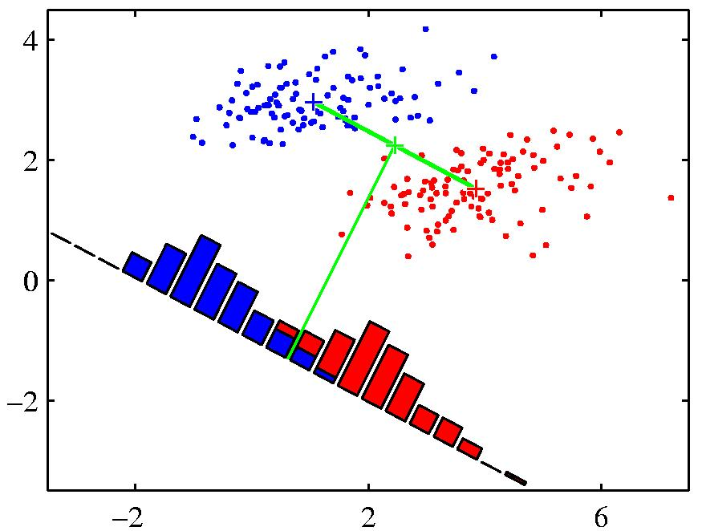
What do we mean by ‘best separation’?
When projected onto the line joining the class means, the classes are not well separated.
Slides from www.cs.toronto.edu/~hinton
Notes:
An obvious direction to choose is the direction of the line joining the class means. But if the main direction of variance in each class is not orthogonal to this line, this will not give good separation

Slide 43
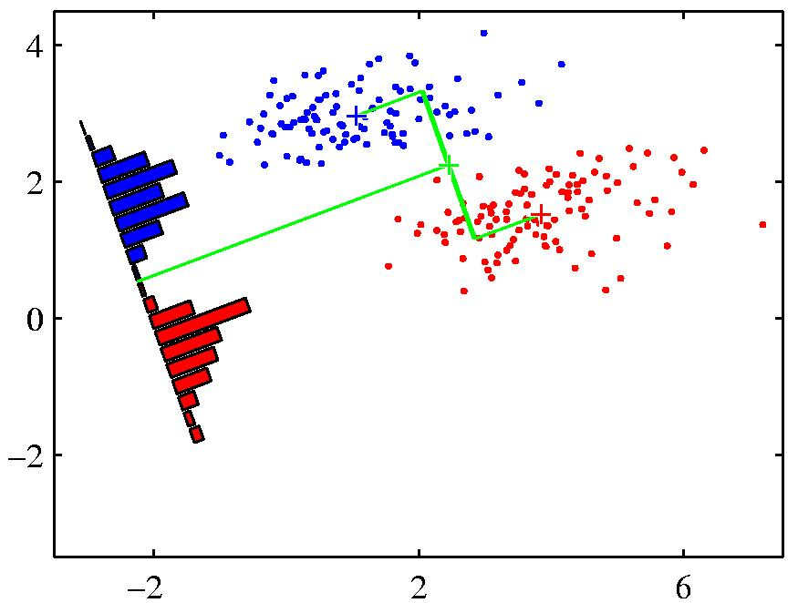
What do we mean by ‘best separation’?
When projected onto the line joining the class means, the classes are not well separated.
Fisher’s Discriminant: A better choice
Slides from www.cs.toronto.edu/~hinton
Notes:
An obvious direction to choose is the direction of the line joining the class means. But if the main direction of variance in each class is not orthogonal to this line, this will not give good separation

Slide 44
Assigning a class
Definition:
Squeezes the real line into [0,1]
Differentiable: (nice exercise)

Slide 45
Soft threshold interpretation
If y> 0, σ(y) goes to 1 very quickly.
If y<0, σ(y) goes to 0 very quickly.
Notes:
Figure 18 from Russell and Norvig.

Slide 46
Probabilistic Interpretation
The sigmoid can be interpreted in terms of the class odds p+/(1-p+)
Exercise: Show the following implication for the class odds:
Therefore the log class odds.
Notes:
P(1+exp(-y)) = 1
P + pexp(-y) = 1
Pexp(-y) = 1-p
p(e^-y)(e^y) = 1-p (e^y)
p/(1-p) = e^y

Slide 47
Logistic regression
Since
we know
so we can estimate w by
minimizing training error
Notes:
P(1+exp(-y)) = 1
P + pexp(-y) = 1
Pexp(-y) = 1-p
p(e^-y)(e^y) = 1-p (e^y)
p/(1-p) = e^y

Slide 48
Learning is just search over the weight space
Searching for local minimum
Incrementally descend along gradient Δ(w)
Update weights using something like:
w_{j} = w_{i} + η Δ(w)
Manipulate step size (η) based on various factors
Typically proportional to E(w, b) -- gradient descent
We can define a convex cost function! (only one minimum)
Notes:
‘kick the duck’ (simulated annealing) ; damped over time – simulated annealing if you have a non-convex function
http://www.quora.com/Convex-Optimization/Why-is-Convex-Optimization-such-a-big-deal-in-Machine-Learning

Slide 49
Minimizing regularized training error E
L is a ‘loss’ function whose definition can vary (affects the details of what we learn)
an upper bound on mis-classification error
R is a ‘regularization term’ which penalizes model complexity
α affects R’s impact on the search

Slide 50
Goals for today
Review last Tuesday
Quiz 8
Quiz 7 answers
Discuss infrastructure issues for Big Data
Talk about streaming data
Look at Regression algorithms
Discuss Machine Learning for Big Data
Talk about Byte 6

Slide 51
How do we handle big data
Two approaches
Distribute the work (parallelize)
Break the work up into smaller batches
Algorithms that can operate on partial data sets are key

Slide 52
Regression for big data
Batch mode : Gradient Descent
w_{j} = w_{i} - η Δ(w) over the entire data S
Difficult to parallelize

Slide 53
How do we handle big data
Batch mode : Gradient Descent
w_{j} = w_{i} - η Δ(w) over the entire data S
Incremental mode: stochastic gradient descent
w_{j} = w_{i} - η * approximation of Δ(w) based on t_{x}-o_{d}
(difference between ideal target value and w^{T}x)

Slide 54
How do we handle big data
Batch mode : Gradient Descent
w_{j} = w_{i} - η Δ(w) over the entire data S
Incremental mode: stochastic gradient descent
w_{j} = w_{i} - η * approximation of Δ(w) based on t_{x}-o_{d}
can approximate Batch Gradient Descent arbitrarily closely if η is small enough
supports online learning
easily parallelized

Slide 55
Machine Learning in Parallel
Distributed machine learning
Mahout [uses Hadoop]: supports clustering, classification and collaborative filtering
MLBase: In-memory solution that chunks data and incrementally adds it to the training.
Python + NumPy [in memory] + SciPy [in memory] + Pandas [support many things]
iPython in parallel
Notes:
http://pandas.pydata.org/
http://strata.oreilly.com/2013/03/python-data-tools-just-keep-getting-better.html
http://cloudcelebrity.wordpress.com/2012/04/25/machine-learning-libraries-in-python/

Slide 56
Goals for today
Review last Tuesday
Quiz 8
Quiz 7 answers
Discuss infrastructure issues for Big Data
Talk about streaming data
Look at Regression algorithms
Discuss Machine Learning for Big Data
Talk about Byte 6

